Slide 1
Functionalities and Applications

Slide 2
Special functionalities of sequence data
Compared to itemsets and matrices, there are special functionalities tied to sequence data

Slide 3
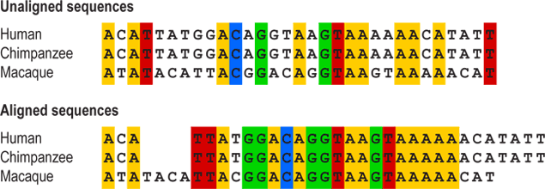
Special functionalities of sequence data
Sequence alignment: aligning the actual positions in multiple sequences to extract common patterns or similarity
shift
Image source: University of California Museum of Paleontology - https://evolution.berkeley.edu/evolibrary/article/0_0_0/evotrees_build_04

Slide 4
Special functionalities of sequence data
Sequence alignment: aligning the actual positions in multiple sequences to extract common patterns or similarity
Prediction: given previous items, predict the next item in order
Introduction to Python
Python for Data Manipulation
Data Mining I
Data Mining II
?

Slide 5
Applications of sequences
Text data
sequences of words
Biological data
e.g., DNA sequences
Protein sequences
Behavioral data
sequences of actions
Transportation data
sequences of locations

Slide 6
What you should know
How to represent ordered itemsets and vectors as sequences
Difference between sequences and other data representations
Many special data mining tasks rely on sequence representation of data

Slide 7


School of Information, University of Michigan
Qiaozhu Mei
School of Information
All Content © Presenter

